Slide 1
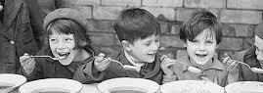
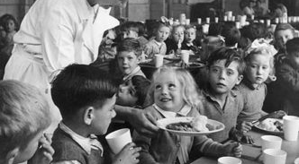
Curating the History of School Meals: Memory, Experience and Methodology,
Heather Ellis
(University of Sheffield)

Slide 2
The School Meals Service: Past, Present – and Future? ESRC/AHRC funded - UCL - University of Wolverhampton - University of Sheffield @ESRCSchoolMeals

Slide 3
Project Aims
To explore the aims, achievements and limitations of the UK School Meals Service (SMS) from its inception in 1906.
To seek to discover through a combination of historical and ethnographic approaches, the impact of the SMS on schools, communities and pupils.
To ask what lessons policymakers, local authorities. schools and researchers can learn from the lived experiences of those receiving school meals, teachers and catering staff, both now and in the past.

Slide 4
Project Team
Prof Gary McCulloch (UCL)
Dr Gurpinder Singh Lalli (University of Wolverhampton)
Dr Heather Ellis (University of Sheffield)

Slide 5
Project Partners
Dr Jason O’Rourke, Headteacher Washingborough Academy, Lincoln
Taste Education
Soil Association
APPG School Food

Slide 6
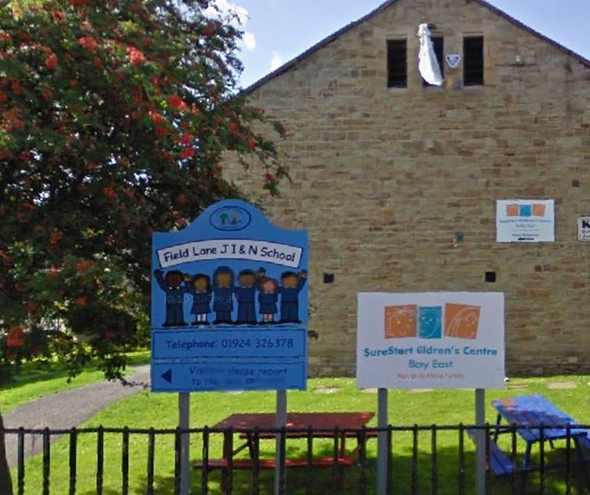
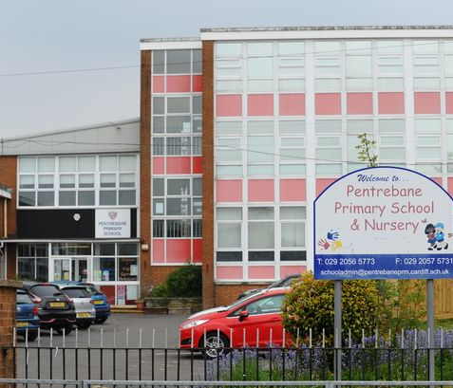
Partner Schools
Woodmansterne Primary School, Streatham
Field Lane Primary School, Bradford
Cadder Primary School, Glasgow
Pentrebane Primary School, Cardiff

Slide 7
A ‘usable past’?
What view of the past are we working with?
Tyack & Cuban (1994) – the notion of a 'usable past’
Based on the assumption that the understanding of change is crucial to the work of both the historian and the policymaker. ‘What historians can do is identify a major educational issue and map out the origins of the policy-making process with its ideological twists and turns, its competing interest groups and their mercurial intentions, and the complex interplay between events, intentions, power, and outcomes as they get played out in educational institutions’ (Cuban 1991: 202).
It is not just historical analysis of policy formation that is important but also how policy is implemented and adapted in schools; and, crucially, how it impacts upon children. Cuban (1991) stresses for the past to be ‘usable’ by policymakers, historians must examine not just the ‘“why” and the “how” of policies’ but also ‘what happened after the policy was adopted’ (203); how did it affect children’s lives, experiences, perceptions of school? And how does it continue to affect them in the present?

Slide 8
Project Strands
Strand 1: Policy History
What were the changes in school meals provision from 1906 onwards? How do these changes relate to government policy? What were the intentions behind such policies?
Strand 2: Social History
A social history based on the lived experiences of teachers, school catering staff and students who received school meals. What are their memories? What were their emotional and sensory responses to school meals, school canteens and other eating spaces?
Strand 3: Ethnographic Case Studies
A set of ethnographic case studies involving four partner schools today; as part of this strand, interviews with children, teachers and school catering staff, and a set of specially designed, co-created activities will be carried out with children in school intended to capture their experiences of school meals.

Slide 9
Strand 2: Social History of School Meals

Slide 10
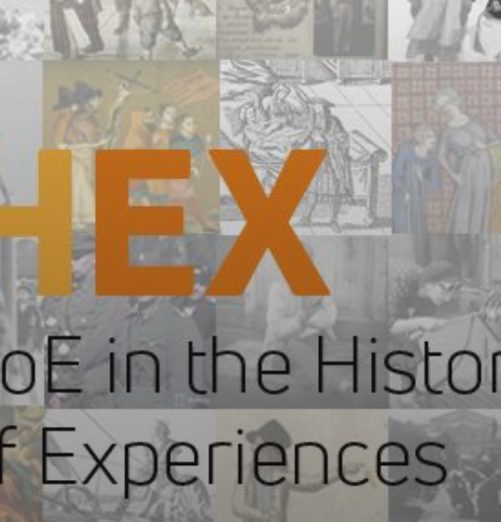
History of Experience
To address the question of how school meals policy affects children’s lives, we will draw on the lens of the history of experience, which seeks to gain insights into lived experience through a range of pre-existing approaches including the history of emotions and sensory history (Smith 2007; Smith and Boddice 2020; Ellis 2011, 2017; Kivimäki et al 2021).
The history of the SMS is not simply one of rational or cognitive responses to a policy problem, but one of lived struggles on a daily basis that are largely sensory and emotional in nature.

Slide 11
Sensory Histories
Sensory History ‘involves foregrounding the non-cognitive dimensions of sensation, including the five senses of smell, sound, touch, taste and sight’ (McCulloch, 2011: 500)
We now have histories of smell in classical antiquity (Harvey, 2006) and modern France (Corbin,1986), of touch in early modern Europe (Gowing, 2003) and 18th-century America (Smith, 2008), of sound in 20th-century Britain (Picker, 1999/2000) and colonial Australia (Carter, 1992: see p.862), of taste in medieval England (Woolgar, 2007) and the 18th-century transatlantic world (Gabbacia, 2005).
Most recently, historians have begun to tackle the history of intersensoriality – how the senses worked together and in concert, rather than in isolation (e.g. Smith, 2007).

Slide 12
Challenges of using sensory histories
Since its beginnings, sensory histories have shown the important role which the senses play in the history of power and social relations.
Peter Hoffer (2003) has highlighted how children have historically ‘enter[ed] the sensate environment to conform to learned priorities of sensation’(6).
Historians like Hoffer and Alain Corbin (1995) have introduced terms such as ‘sensuous etiquette’ and ‘sensory regime’ to describe this phenomenon where training of the senses is used to inculcate desirable traits and characteristics in poor and working-class children, prisoners, hospital patients and other ‘contained’ populations.

Slide 13
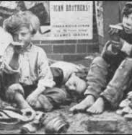
Geert Thyssen (2019) has recently taken this interpretation further, exploring the notion of ‘smellscapes’ and the use of smell to demarcate class boundaries.
He focuses on the 1860s and the height of the sanitary reform movement when ‘attention increasingly turned to people’s effluvia, breath and body odour.’
He describes a process of ‘colonization of the world of poor children’ in which ‘the absence of smell became synonymous with a range of civil values such as self-control, order, and patriotism; odorous others were identified as potential disruptors of moral order.’

Slide 14
Children’s Experience of Hunger and School Meals
What these approaches cannot tell us much about is how the children themselves experienced hunger and school feeding, whether, from their perspective, this ‘colonizing project’ was successful.
Cathy Burke and Geert Thyssen both hint at the possibility of resistance. Cathy describes ‘food and drink in schools’ becoming potentially ‘a site of contested desires, a space where authority and resistance are exercised’ characterised by ‘chaos’ and unruly behaviour.
Geert Thyssen admits that there must have been families who ‘maintained their eating habits’ and children who ‘resisted the open-air school diet’ but says that this is difficult to establish as ‘ego-documents offering insight into the sensory experiences of children themselves, unfortunately, are in short supply.’

Slide 15
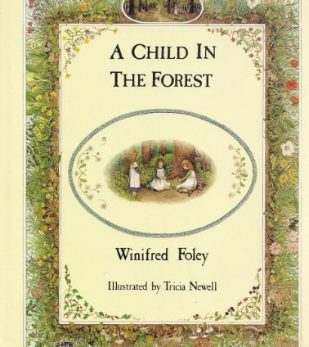
SOURCES
(i) Published memoirs e.g. Winifred Foley (A Child in the Forest – Forest of Dean, 1920s)
“Tuberculosis followed malnutrition, and some of the village children were sent to sanitoria. Lucky things, we thought; but the rest of us had some good luck too – “they” started free dinners at school. I don’t remember who “they” were, but I do remember the dinners. Our Mam tried to get some sort of meat for Sunday dinner but now it was meat every day – beautiful stews, corn beef, mince! And pudding as well –rice pudding made with milk, jam roly poly, and (crowning delicacy) treacle pudding. This I liked above all else.”

Slide 16
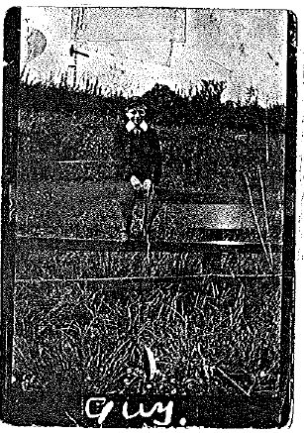
(ii) Unpublished memoirs and autobiographies
Burnett Collection of Working-Class Autobiography, Brunel University Library
Archive of Working-Class Writing Online
Guy Oates (b. 1905 attended the Yorkshire Society’s School in Lambeth(a charity boarding school) during WW1)
During school meals, Guy writes, the boys were “never given gravy, custard, sauces and syrup.” When wartime privations were at their worst, he recalled “real hardship” where he would get “no breakfast at all and sometimes little or no tea all on the same day.” Looking back he recalls the feeling of having his “dignity lowered” by the experience.

Slide 17
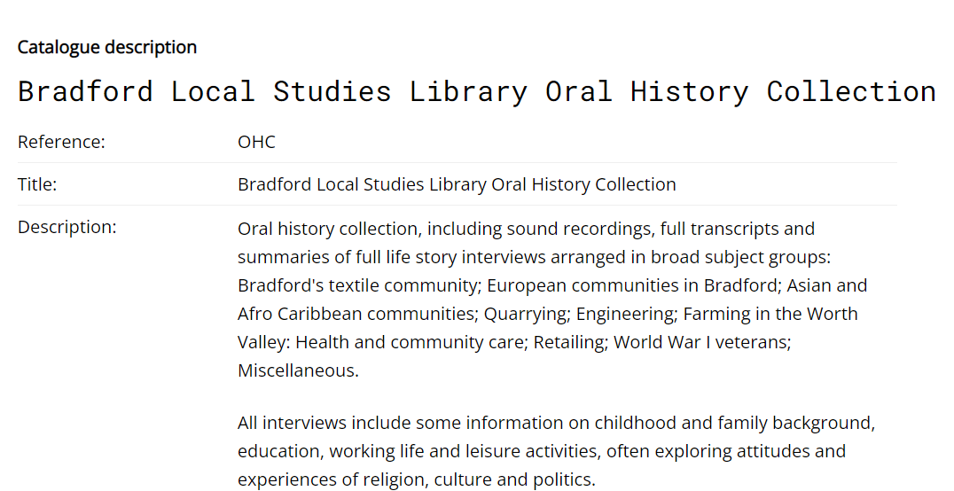
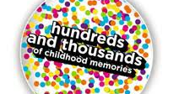
(iii) Existing oral history archives
E.g. Those located in Bradford, London, Cardiff and Glasgow as well as national collections.
e.g. Appeal for memories of Margaret McMillan on the centenary of her birth in 1960s (University of Greenwich)
Hundreds and Thousands of Childhood Memories project run by the Children’s Society in 2008.

Slide 18
(iv) New Oral Histories
New oral histories from approximately 100 individuals from across the four nations.
Recruitment both through partner schools and an online call for participants
These oral history interviews will follow the ‘Listening Rooms’ approach developed by Emma Heron (2019), setting up ‘listening booths’ in which pairs of friends or relatives are provided with a list of topics or questions (on cue cards) and asked to discuss these freely together over a period of 30 minutes to an hour.
Interviews will be held with former students, their family members, teachers and school catering staff.s) and asked to discuss these freely together over a period of 30 minutes to an hour. Together, these interviews will create a unique repository of individual and shared testimony and a valuable data set for historians and community researchers in the future.

Slide 19
Curation…
Great topic for starting a new project.
What do we mean by curation? ‘The action or process of selecting, organizing, presenting, and looking after the items in a collection or exhibition’ (OED)
Forces us to think about two things:
1. My impact as a curator: how do my choices in terms of selection of sources/evidence, organisation and presentation of findings impact the research I produce? Especially as part of a multidisciplinary team.

Slide 20
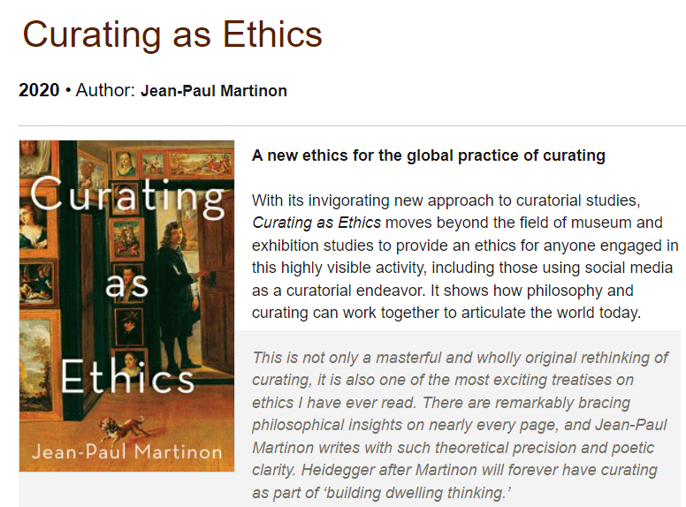
2. What are the ethical implications of doing this kind of research?
Implied by the emphasis on ‘looking after’ - literally care (Latin ‘cura’) -at the heart of the idea of curation.
What are the responsibilities I as a researcher have towards people in the past?
They might be dead themselves but close family members may still be alive. Questions of dignity?
What about the people interviewed for the project today? The students, teachers, parents, grandparents, catering staff?

Slide 21
Please do follow us on twitter @ESRCSchoolMeals!

