Slide 1
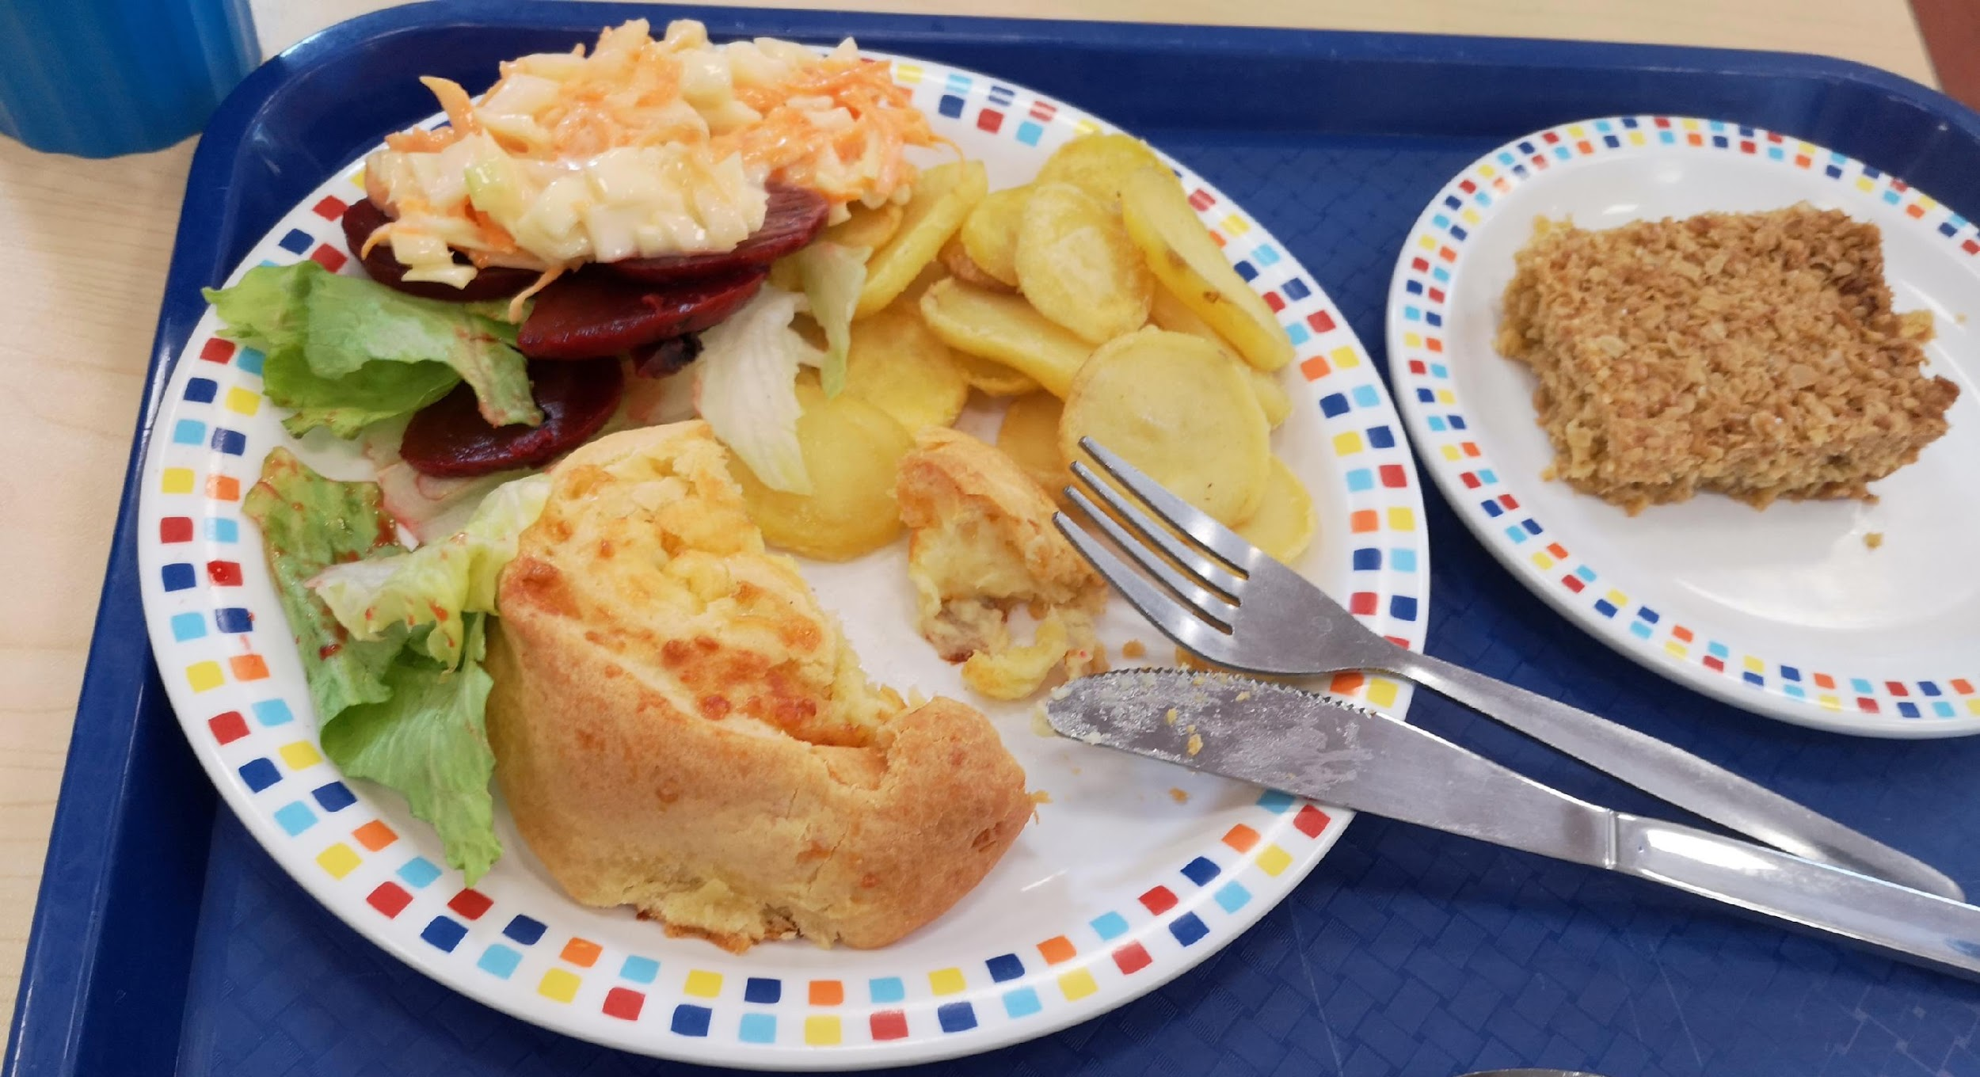
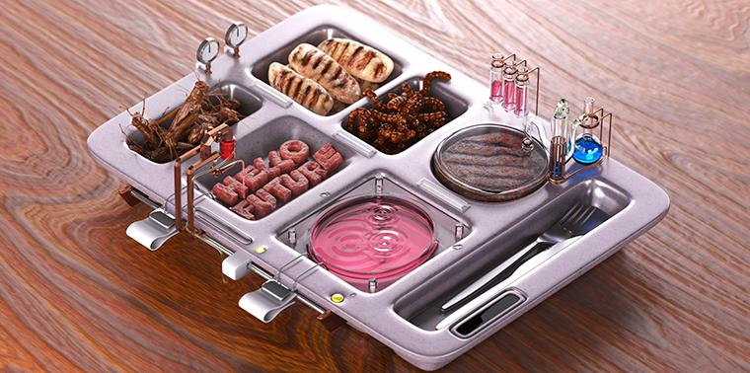
School Meals: Past, Present and Future
www.theschoolmealsproject.co.uk
Dr Ellen Bishop, University of Wolverhampton
Dr Izzy Carter, University of Sheffield

Slide 2
Today’s Session
To recap the content of our first session.
To create interview questions about the history of school meals.
To conduct oral history interviews with past Field Lane pupils, staff, or family members.
To reflect on what we found out about people’s experiences of the past and being an historian.

Slide 3
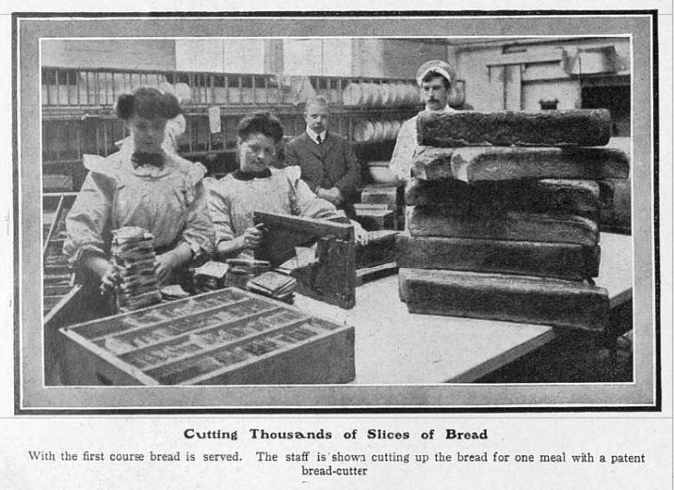
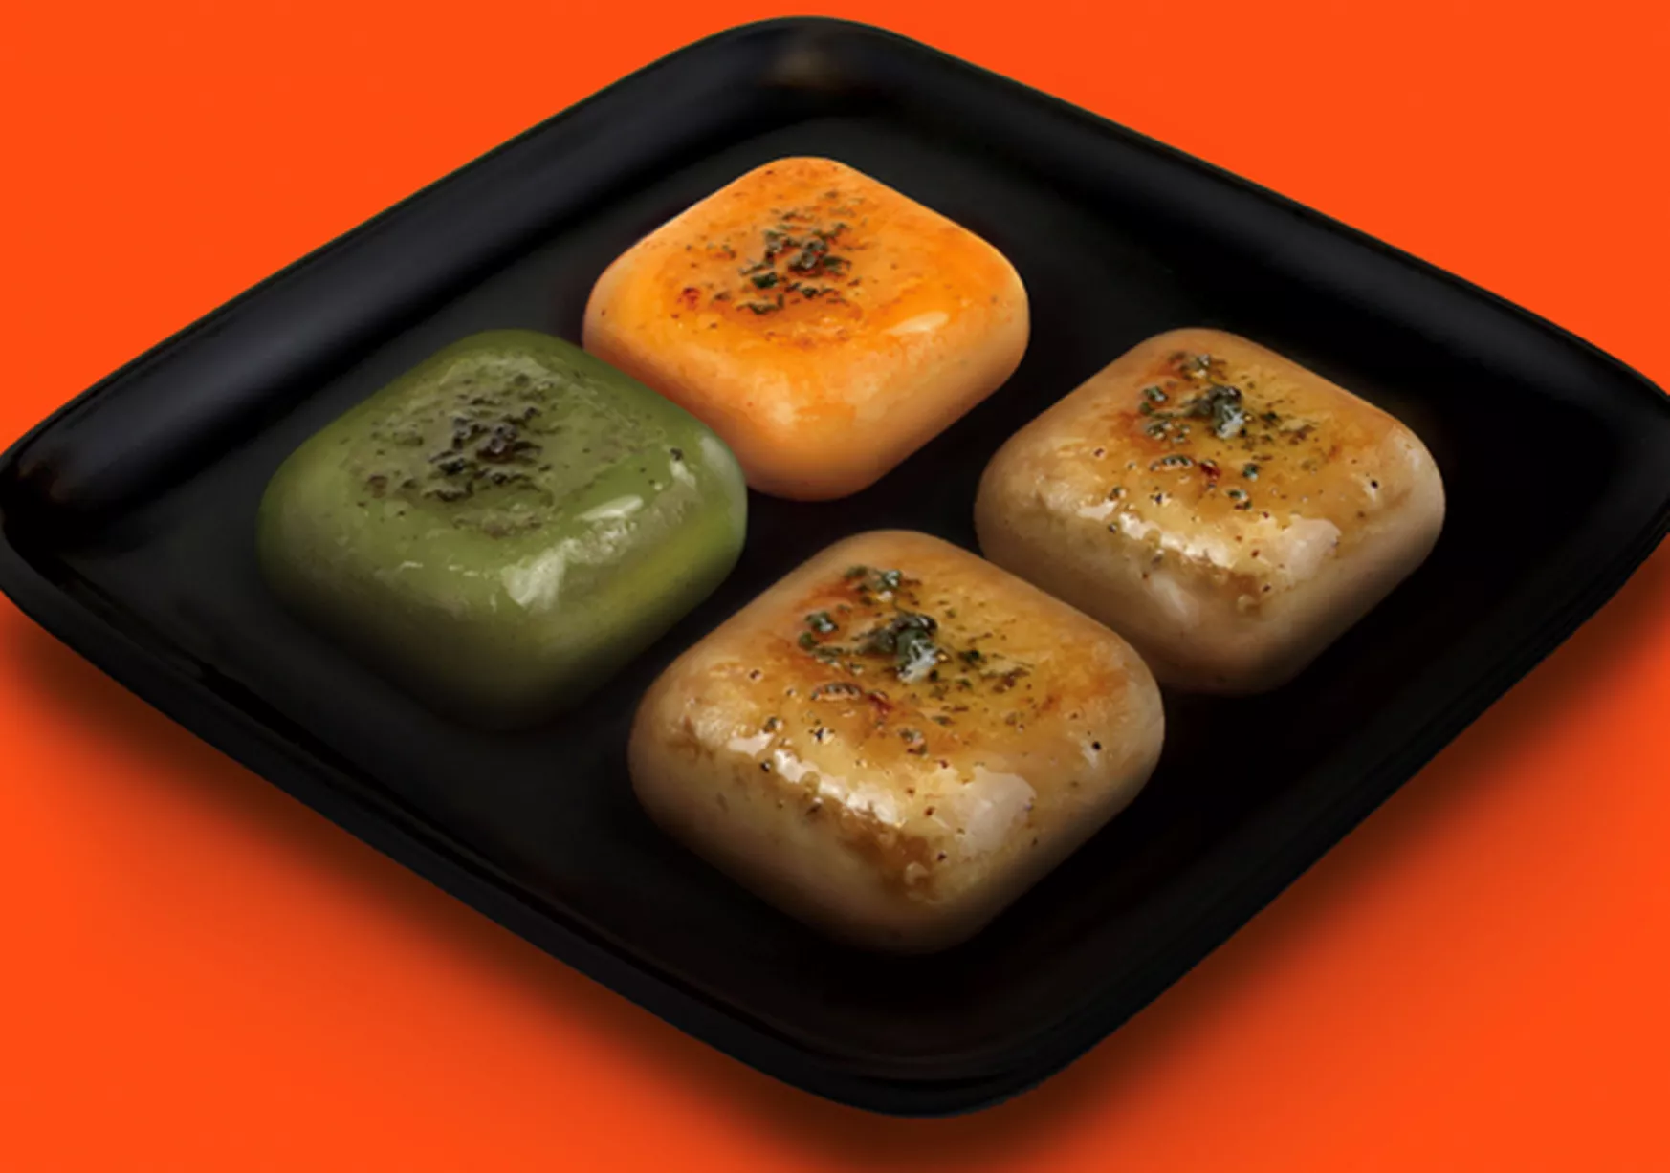
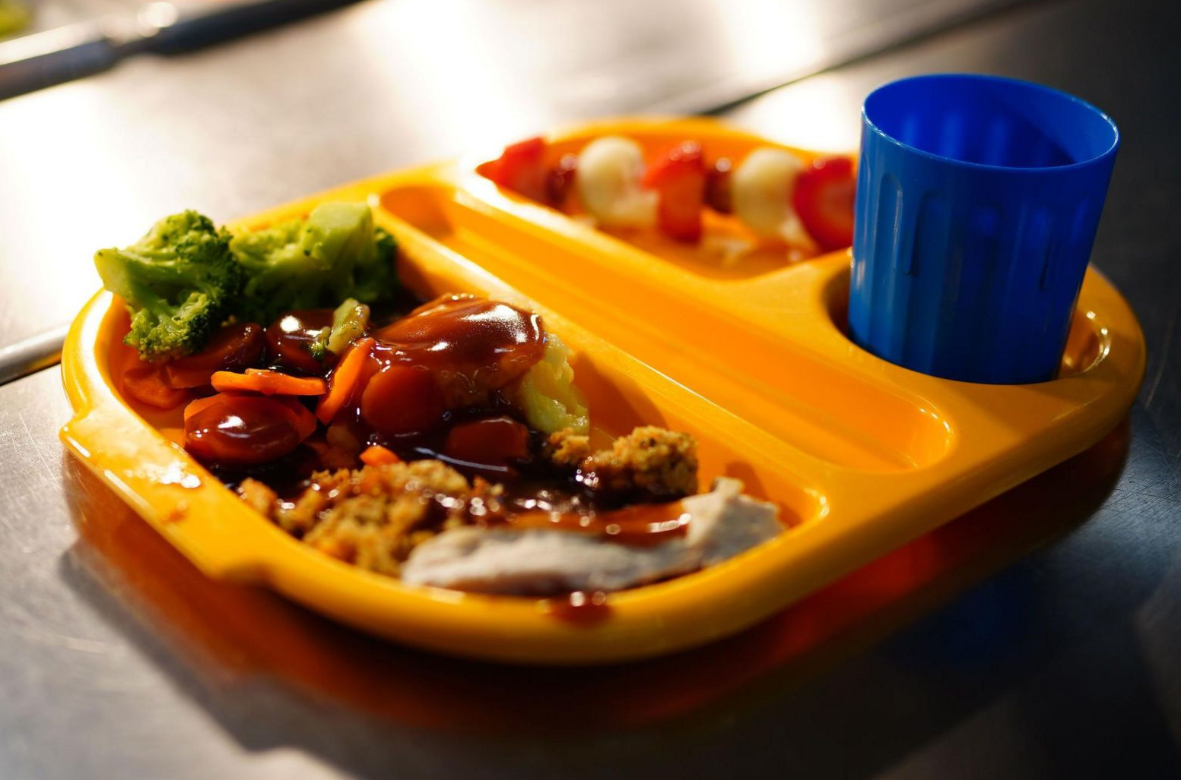
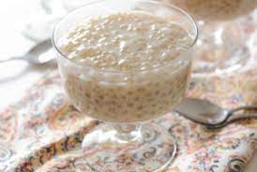
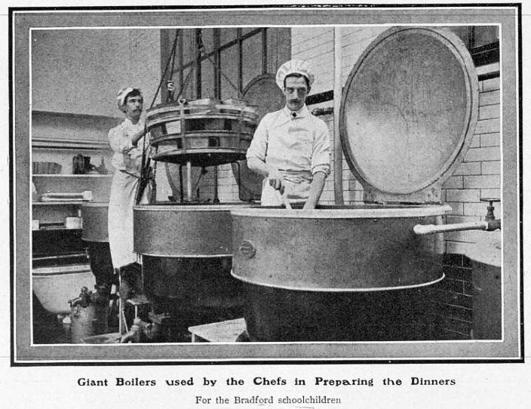
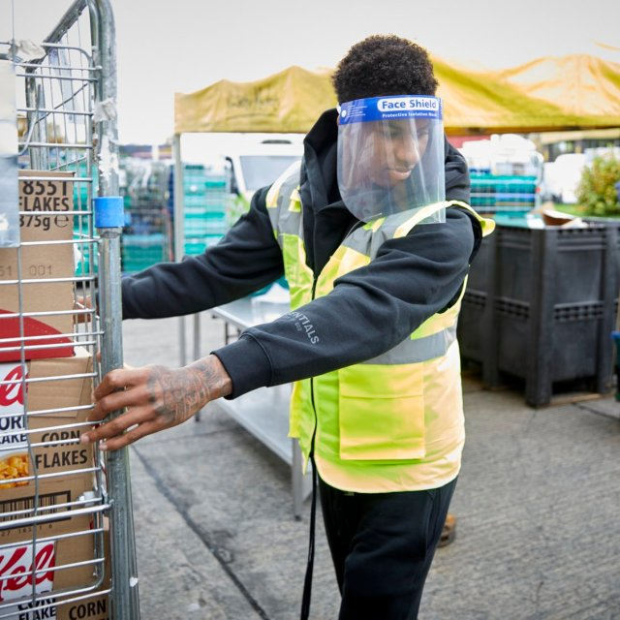
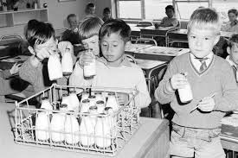
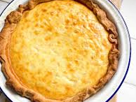
What do you remember learning in our last session about school meals in the past (and future)?

Slide 4
Name
School meal of the Past / Future

Slide 5
What makes a good interview question?
Questions that are open.
Questions that are neutral.
Questions that are easy to understand.
What are some examples of good and bad interview questions we might use or avoid today?

Slide 6
Activity 1: Asking questions
Think of five questions that you would like to ask your interviewee about school meals.
What can you ask that helps you to find out the most about your interviewee’s thoughts on school meals in the past and future?
How might you use your drawing from last time as part of one of the questions?

Slide 7
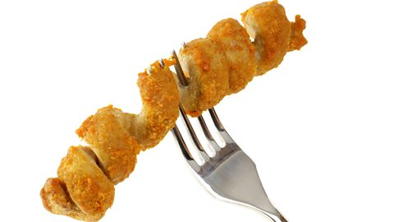
Activity 2: Interviews!
Can you tell me more about that?
Remember, if you get stuck…
If you could only tell me one thing, what you would you tell me?
What do you remember most about that?
What do you find most interesting about that?

Slide 8
Activity 3: Interview reflections
What was the most interesting thing you found out?
What did you enjoy most about being an interviewer?
What did you find most challenging?
If you did an interview again, what topic would you ask about and why?

