Slide 1
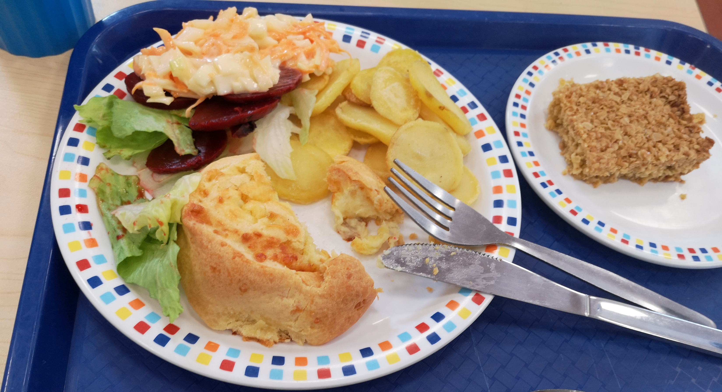
School Meals: Past, Present and Future
www.theschoolmealsproject.co.uk
Dr Izzy Carter, University of Sheffield
Dr Ellen Bishop, University of Wolverhampton

Slide 2
Today’s Session
To learn about the history of school meals in Britain and how they might change in the future.
To design our own school meals of the past or future.
To find out what makes a good interview.
To understand how to conduct an oral history interview.
To test our interviewing skills!

Slide 3
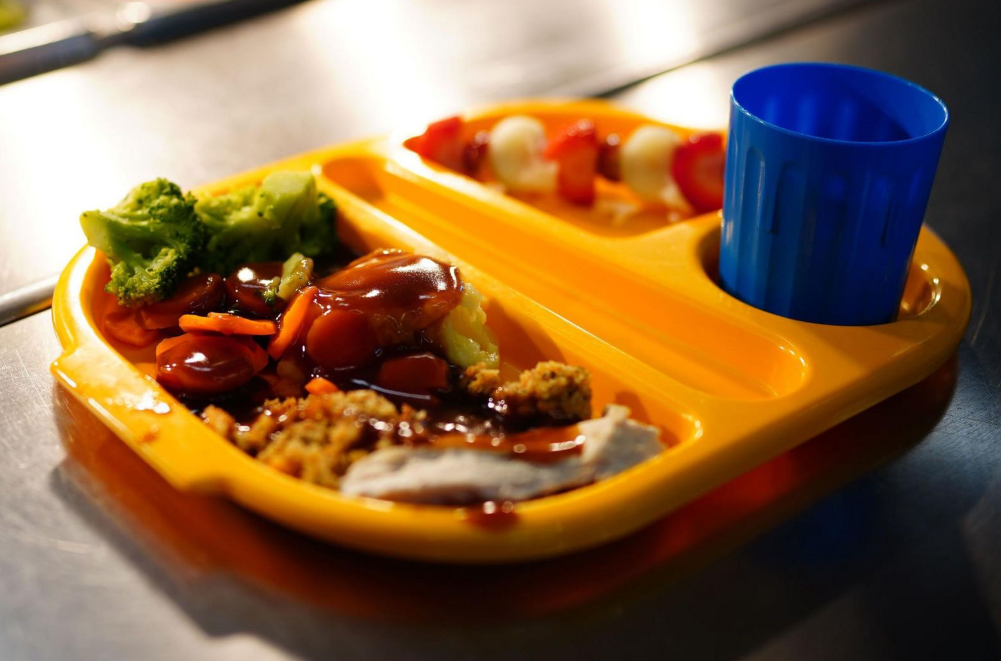
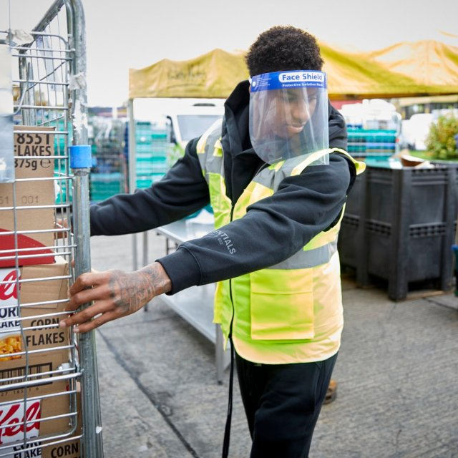
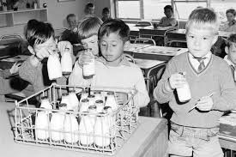
The History of School Meals
1906
The School Meals Service is introduced. Bradford becomes the first place to provide meals to school children.
1934
Primary school children become entitled to free milk at school.
1940
The government agrees to spend more money on school meals. The number of children eating food in school increases.
1955
Nutritional standards are introduced.
1971
Free milk no longer provided for school children.
1980
Nutritional standards scrapped.
1998
Nutritional standards are reintroduced.

Slide 4
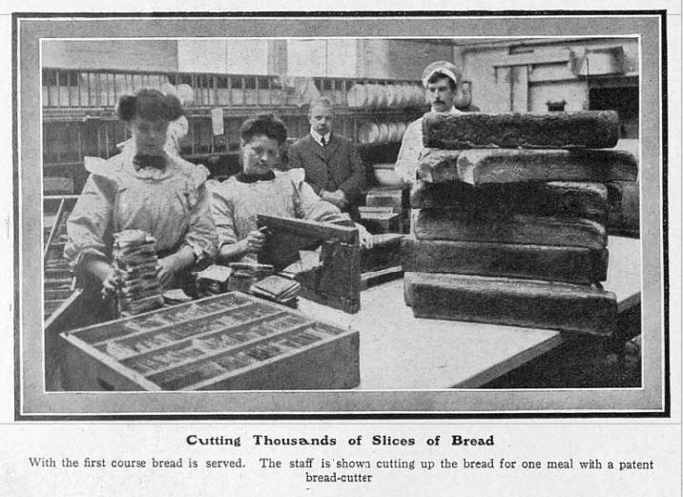
Notes:
Bradford school meals in 1908

Slide 5
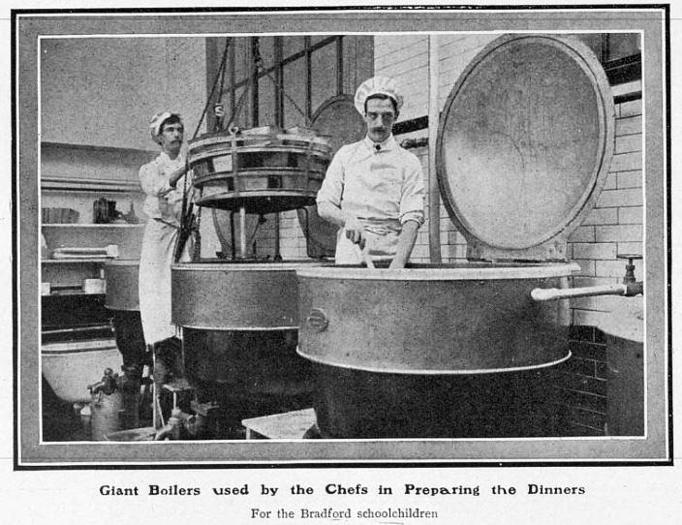
Notes:
Bradford school meals in 1908

Slide 6
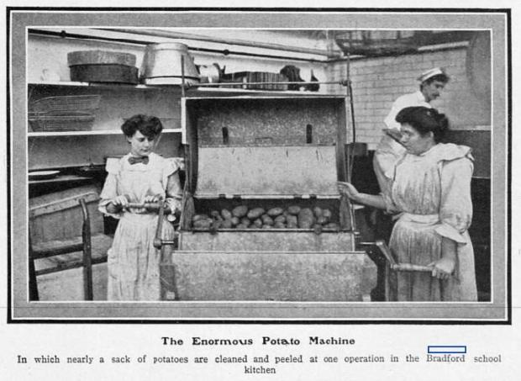
Notes:
Bradford school meals in 1908

Slide 7
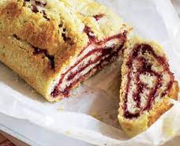
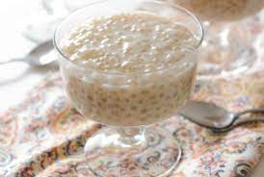
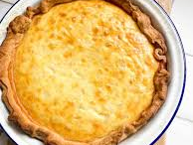
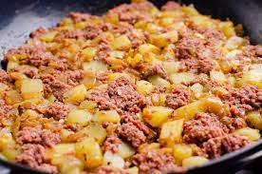
Here are some examples of what school meals looked like in the past…

Slide 8
Where do you think these photos were taken?
What year do you think they were taken?
Notes:
1971-72

Slide 9
What do our interviewees remember?
How do these memories differ from your school meal experiences now?

Slide 10
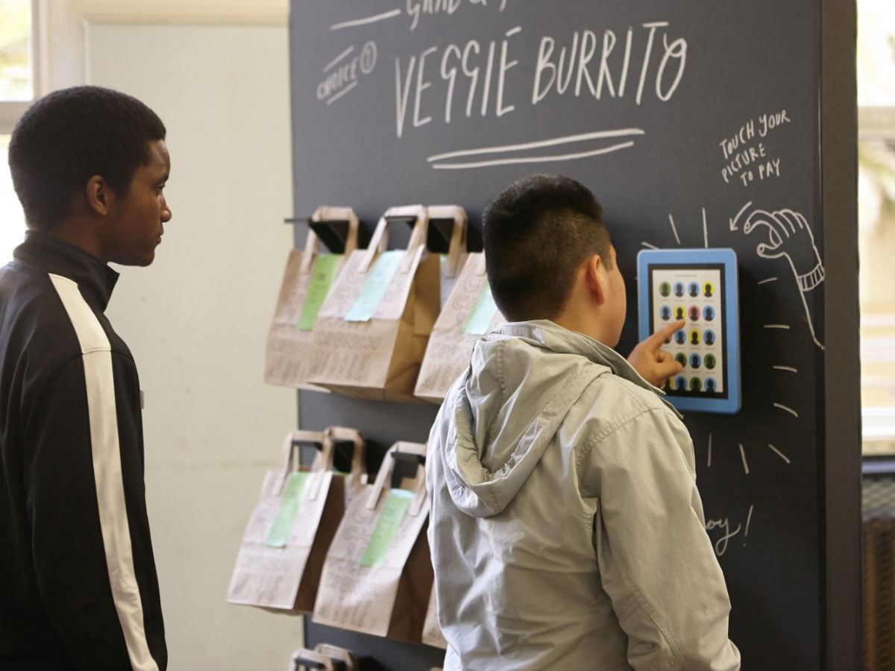
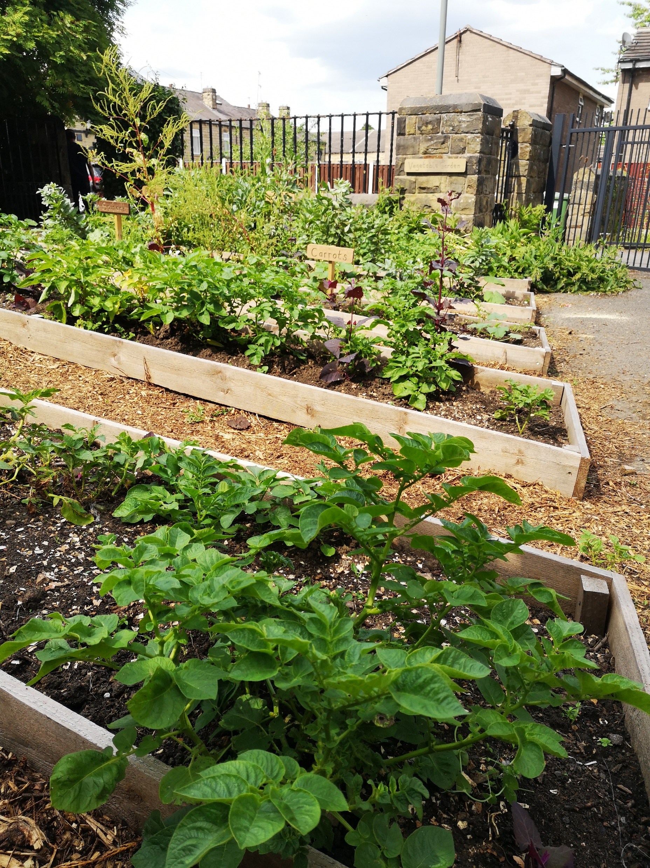
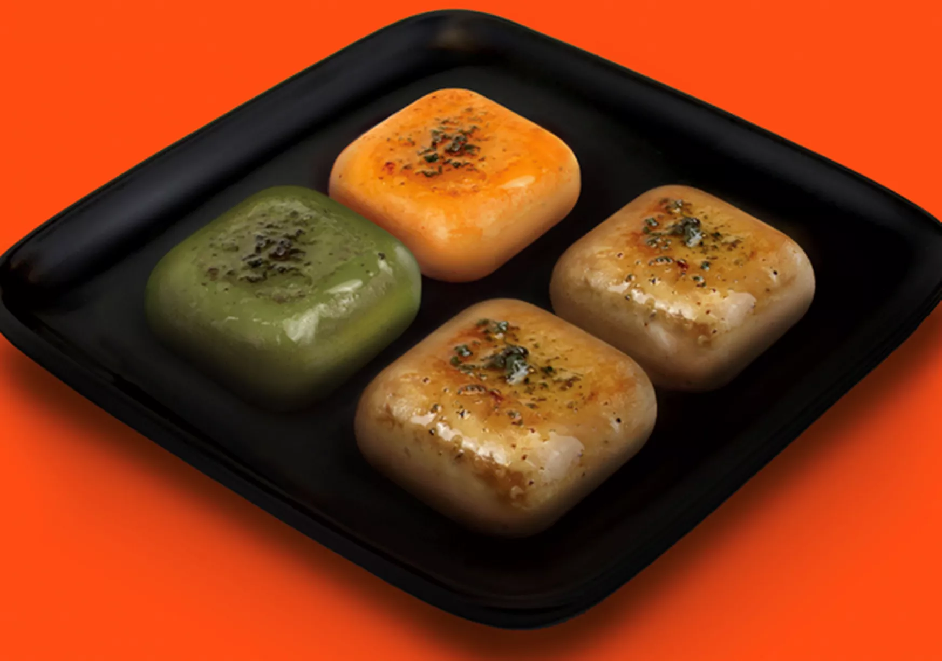
What could school meals look like in the future?
Growing food for the canteen on site?
Cashless system- pre-ordering online or in the dining room?
Alternative sources of protein? (e.g. vegetarian foods like Quorn and Tofu, alternative protein- insects, lab-grown meat?, futuristic foods?)
Expansion of free school meals to all?

Slide 11
Activity 1: School meals of the past or future
1) Using the materials on your desks either:
Draw what you think a school meal might have looked like in the past
OR what you think a school meal might look like in the future
2) Stick your plate onto the sheet of paper and write some notes around it
about what you have drawn and why.
Things to think about:
What’s on the plate and why did you choose it?
Is the food healthy or unhealthy? What does it taste like?
Where is the food being eaten? Is the room noisy, bright, clean, smelly?
What do you think school meals were like in World War 2?
What do you think school meals will be like in 2050?
What do you think school meals were like for your parents, grandparents, or great-grandparents?
What might school meals to be like if you have children?

Slide 12
Name
School meal of the Past / Future

Slide 13
Oral history training
www.theschoolmealsproject.co.uk

Slide 14
Asking questions
Try to ask open questions, rather than closed questions.
Why ask open questions?
They help to avoid yes/no answers.
They are less likely to influence how the person you are interviewing answers.
They help the person you are interviewing to talk about what they find most interesting or important.

Slide 15
Top tip!
Questions should be open, neutral and easy to understand. Make sure to ask them one at a time.

Slide 16
Activity 2: Example questions
Which of these questions might we use in an interview and which should we avoid?
Was that a terrible experience?
Can you tell me more about your school dinners?
Do you remember the Second World War?
Did you feel happy about that?
Is there anything else you would like to add?

Slide 17
Activity 3: Asking questions
Top Tip!
If you get stuck, these questions can help:
Can you tell me more about that?
Think of three questions that you might ask an interviewee about school meals (look at your drawing and notes for some inspiration!)
Try to make sure that your questions are open questions.
Get into pairs and take turns to ask your questions.
If you could only tell me one thing, what you would you tell me?
What do you remember most about that?
What do you find most interesting about that?

Slide 18
Extension Activity: Interviewee Traits
You will be given a specific trait to act out whilst you are the interviewee.
Take turns doing interviews again with your new persona!
After the interview, the interviewer should try to guess what the interviewees trait was
Think about how the trait affected the interview

Slide 19
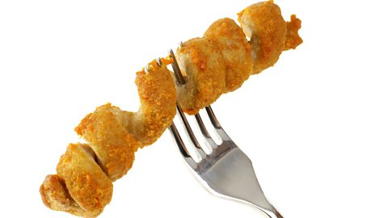
Before the next session on 26th June…
Think about 3 questions that you would like to ask your parent, grandparent or a former student about their school meals!

